Slide 1

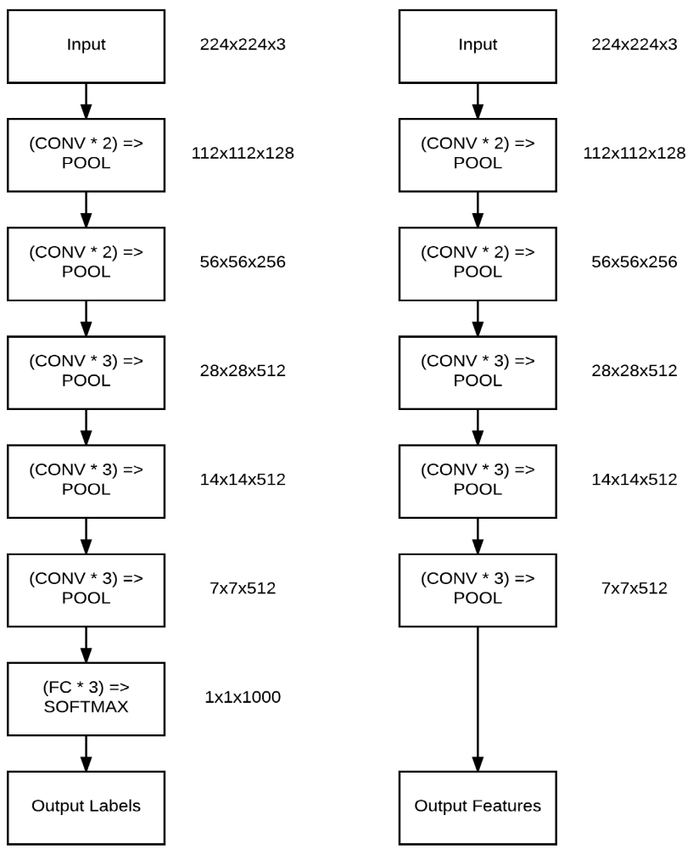
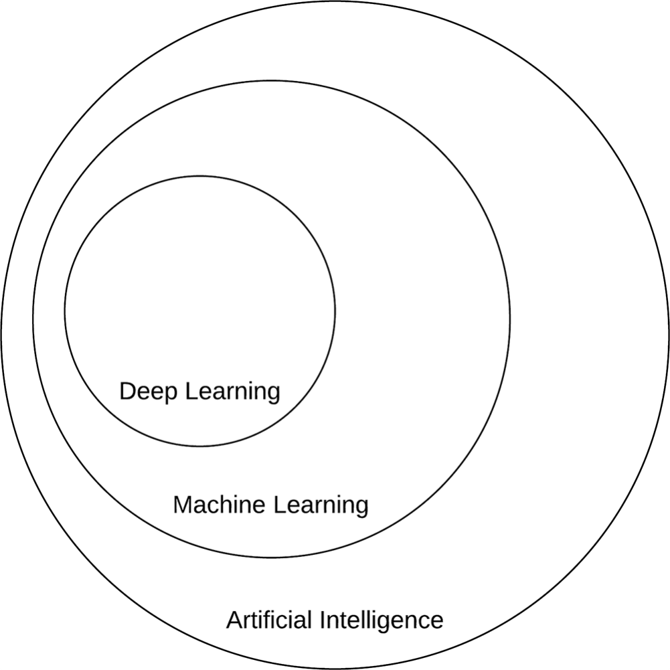

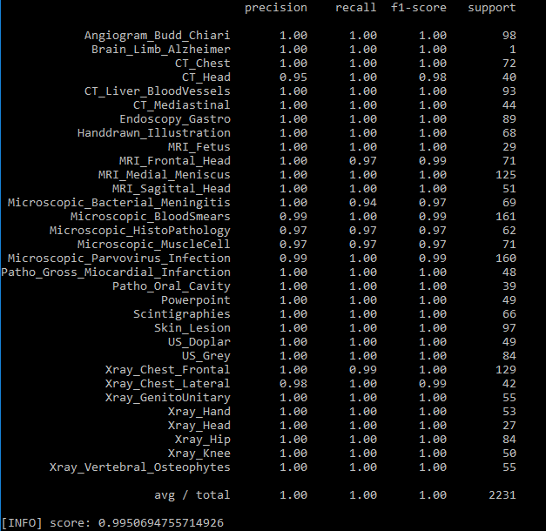
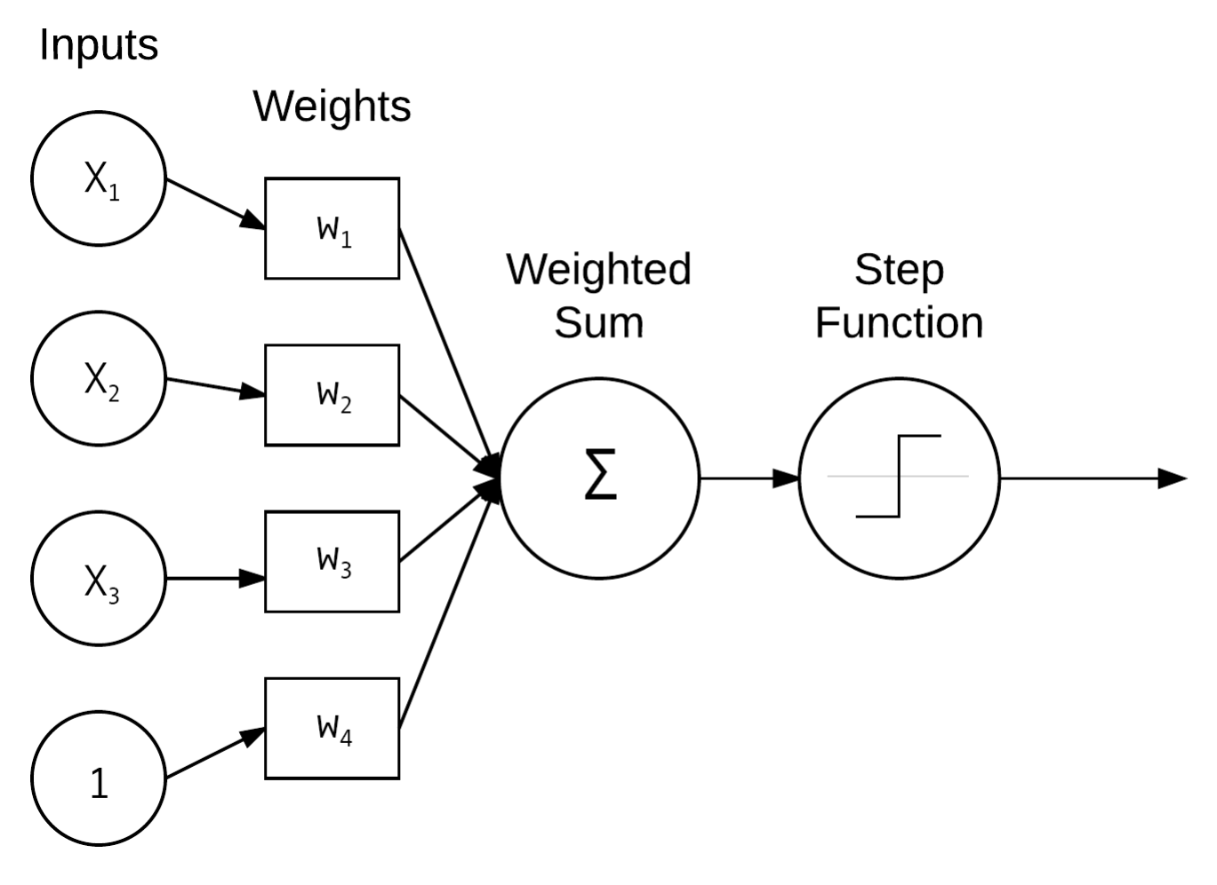
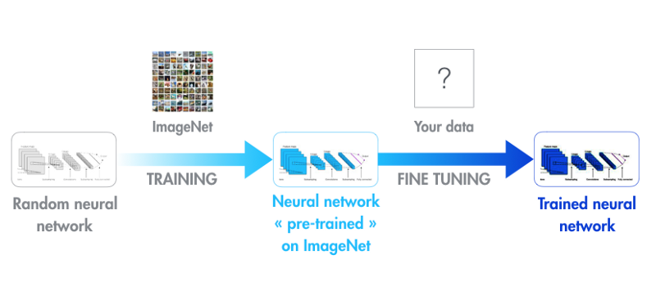
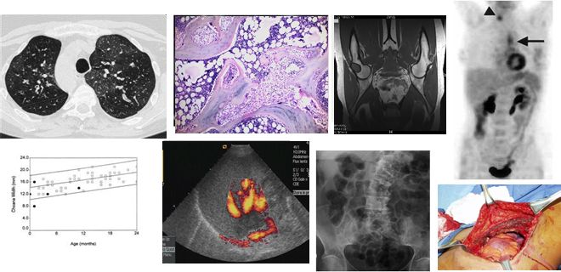
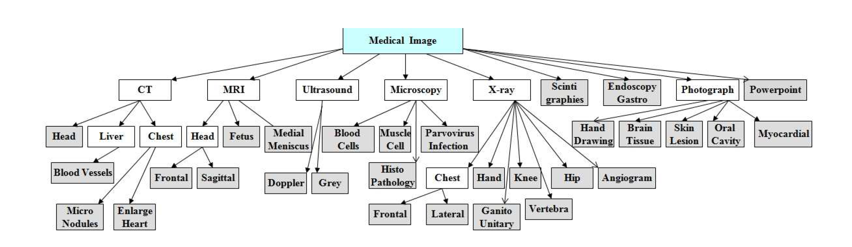
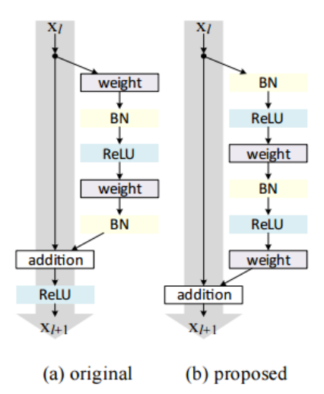
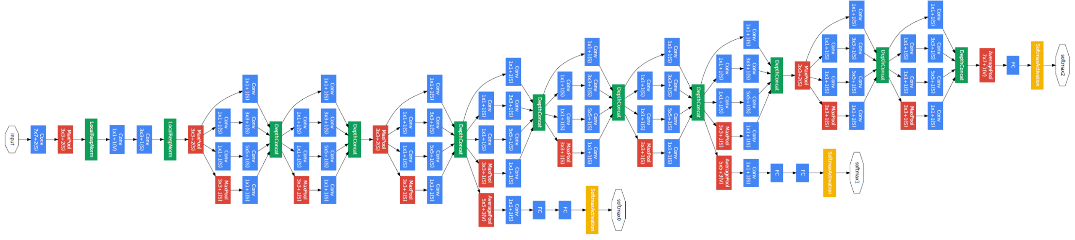
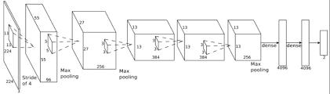
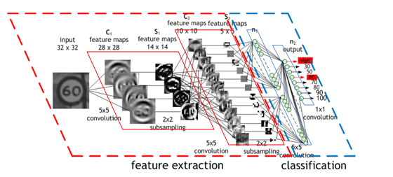
Modality Detection and Classification of Biomedical Images with Deep Feature Extraction by Transfer Learning using Python
Jose Dixon, Mahmudur Rahman, Ph.D. (Mentor)
Computer Science Department, Morgan State University, Baltimore, Maryland
Introduction
Deep Feature Extraction
Result Analysis
Deep Learning is a subfield of machine learning concerned with algorithms inspired by the structure and function of the brain called artificial neural networks.
Deep learning is useful for a lot of
applications
such as face recognition and indexing or
machine learning in self-driving cars.
Deep neural networks trained on large-scale datasets have demonstrated to be excellent at the task of transfer learning.
Images serves a input being processed
through layers.
Features can be extracted with a pre-trained CNN.
The features are written to model.
The features are extracted using a model using a pretrained CNN.
Results are compared together from three deep learning CNNs.
Their three architectures tested individually from each other with the same dataset.
MiniGoogleNet
ResNet
Objective
Deep learning is useful for obtaining a better accuracy on a dataset of images in situations where machine leaning failed to solve challenging problems.
Deep learning has shown promising
outcomes in computer vision, biomedical
research, and image processing.
Deep learning can combine the feature
extraction and classification process
simultaneously to help to fulfill tasks
much more easier.
Transfer Learning
Transfer learning is a machine learning method where a model developed for a task is reused as the starting point for a model on a second task.
Transfer Learning uses pre-trained models that have been used for another task to jump start the development process on a new task or problem.
Transfer Learning can speed up the time it takes to develop and train a model by reusing these pieces or modules of already developed models.
AlexNet
An Example of Deep Learning
Neural Network
Convolutional Neural Networks
Deep Learning Classifier | Precision | Recall | F1-Score | Accuracy (w/ crops) | Accuracy (wo/ crops)
ResNet | 1.00 | 1.00 | 1.00
AlexNet |  |  |  | 1.00 [rank-1] | 0.85 [rank-1]
GoogleNet |  |  |  |  | 0.91 [rank-1] 1.00 [rank-5]
Convolutional Neural Networks Architectures for Deep Learning: ResNet, MiniGoogleNet, and AlexNet.
Each type CNN utilizes it own layers, kernels, and training techniques.
A typical convolutional neural network has a convolutional layer, pooling layer, fully connected layer, receptive field layer, and weights.
ResNet:
architecture can be trained using standard Stochastic Gradient Descent (and a reasonable initialization function) through the use of residual modules.
MiniGoogleNet:
An inception-based network and smaller form of GoogleNet.
It acts a multi-feature extractor by computing 1x1, 3x3, and 5x5 convolutions of levels
AlexNet:
contained eight layers; the first five were convolutional layers, some of them followed by max-pooling layers, and the last three were fully connected layers.
Experiments
The experiments of a dataset was based on 5000 images from the ImageCLEFmed collections. The images are classified into 30 manually assigned disjoint global categories.
Accuracies are compared using different classification techniques by using AlexNet, GoogleNet, and ResNet convolutional neural network architectures.
Conclusion & Future Work
Deep learning can help address the problems that machine learning failed to resolve or provide the best results for.
We will attempt do more deep learning on the following dataset with ranked accuracy, improved techniques, advanced optimization methods.
This work will be used to test with additional convolutional neural networks to evaluate the effectiveness for image processing.
Deep Learning Algorithm
For Image Processing and Classification, Python 3.6 , OpenCV 3.4, and Keras libraries were used.
References
Images serve as input for image processing in deep learning.
The convolutional neural network serve as the feature extractor and classifier simultaneously (as compared to sequentially in machine learning.
Majority of the layers serve as feature extractors before going to final layer of
Herrera, Alba Garcia Seco, and Jayashree Kalpathy-Cramer. “AMIA: Medical task.” ImageCLEF / LifeCLEF - Multimedia Retrieval in CLEF, ImageCLEF, 29 Oct. 2017, www.imageclef.org/2013/medical.
“Modern Machine Learning Algorithms: Strengths and Weaknesses.” (2018, May 20). https://elitedatascience.com/machine-learning-algorithms (accessed 6 August 2018)
Rahman, M., Antani, S. K., & Thoma, G. R. (2010). A classification-driven similarity matching framework for retrieval of biomedical images. 2010 Proceedings of the International Conference on Multimedia Information Retrieval, 147-154.
Simonyan, K., & Zisserman, A. (2014). Very Deep Convolutional Networks for Large-Scale Image Recognition,Abs/1409.1556. http://arxiv.org/abs/1409.1556 (accessed 26 August 2018)
ResNet
GoogleNet
AlexNet

